Slide 1
HOUSING: PRICE PREDICTION
By : Ravinder Singh

Slide 2
Problem Statement
The company is looking at prospective properties to buy houses to enter the market. You are required to build a model using Machine Learning in order to predict the actual value of the prospective properties and decide whether to invest in them or not. For this company wants to know:
• Which variables are important to predict the price of variable?
• How do these variables describe the price of the house?
Business Goal:
You are required to model the price of houses with the available independent variables. This model will then be used by the management to understand how exactly the prices vary with the variables. They can accordingly manipulate the strategy of the firm and concentrate on areas that will yield high returns. Further, the model will be a good way for the management to understand the pricing dynamics of a new market.

Slide 3
Data Reading
The given Project has to different dataset : train and test
We will merge both the data to form a master dataset and will split it before model building
Reason: The data on which model is train and test should be same , by merging dataset we are reducing the efforts (keeping in mind can’t delete any row of the test dataset.
Also some columns in the datasets have as assign values to the column and signifies a categorical variable , but pandas during the data reading will assume them as the missing values .
We need to change the those values to any other variable(None).
Some of the columns have numerical values that are ordinal variables but pandas will read them as the integer values some Numerical variable columns will be read as categorical variable

Slide 4
Data Cleaning
Values that are taken as missing values by Pandas while reading the Data
Alley : NA = No alley access
BsmtQual, BsmtCond, BsmtExposure, BsmtFinType1, BsmtFinType2 : NA = No Basement
FireplaceQu : NA = No Fireplace
GarageType, GarageFinish, GarageQual, GarageCond : NA = No Garage
MasVnrType: NA=No Masonry Type
PoolQC : NA = No Pool
Fence : NA = No Fence
MiscFeature : NA = None
So, we will have to replace these by 'NONE' before finding missing values.

Slide 5
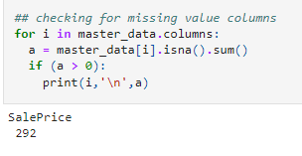
Computing the missing values
Compute the missing values in columns:
LotFrontage and MasVnrArea,Electrical
for LotFrontage and MasVnrArea we will replace Nan values from the mean
For Electrical use mode to replace Nan

Slide 6
Data Exploration
Exploratory Data Analysis refers to the critical process of performing initial investigations on data so as to discover patterns,to spot anomalies,to test hypothesis and to check assumptions with the help of summary statistics and graphical representations.
From next slide onwards there are few plot that I used in my project . For complete Understanding refer the Ipynb file attached to the data

Slide 7
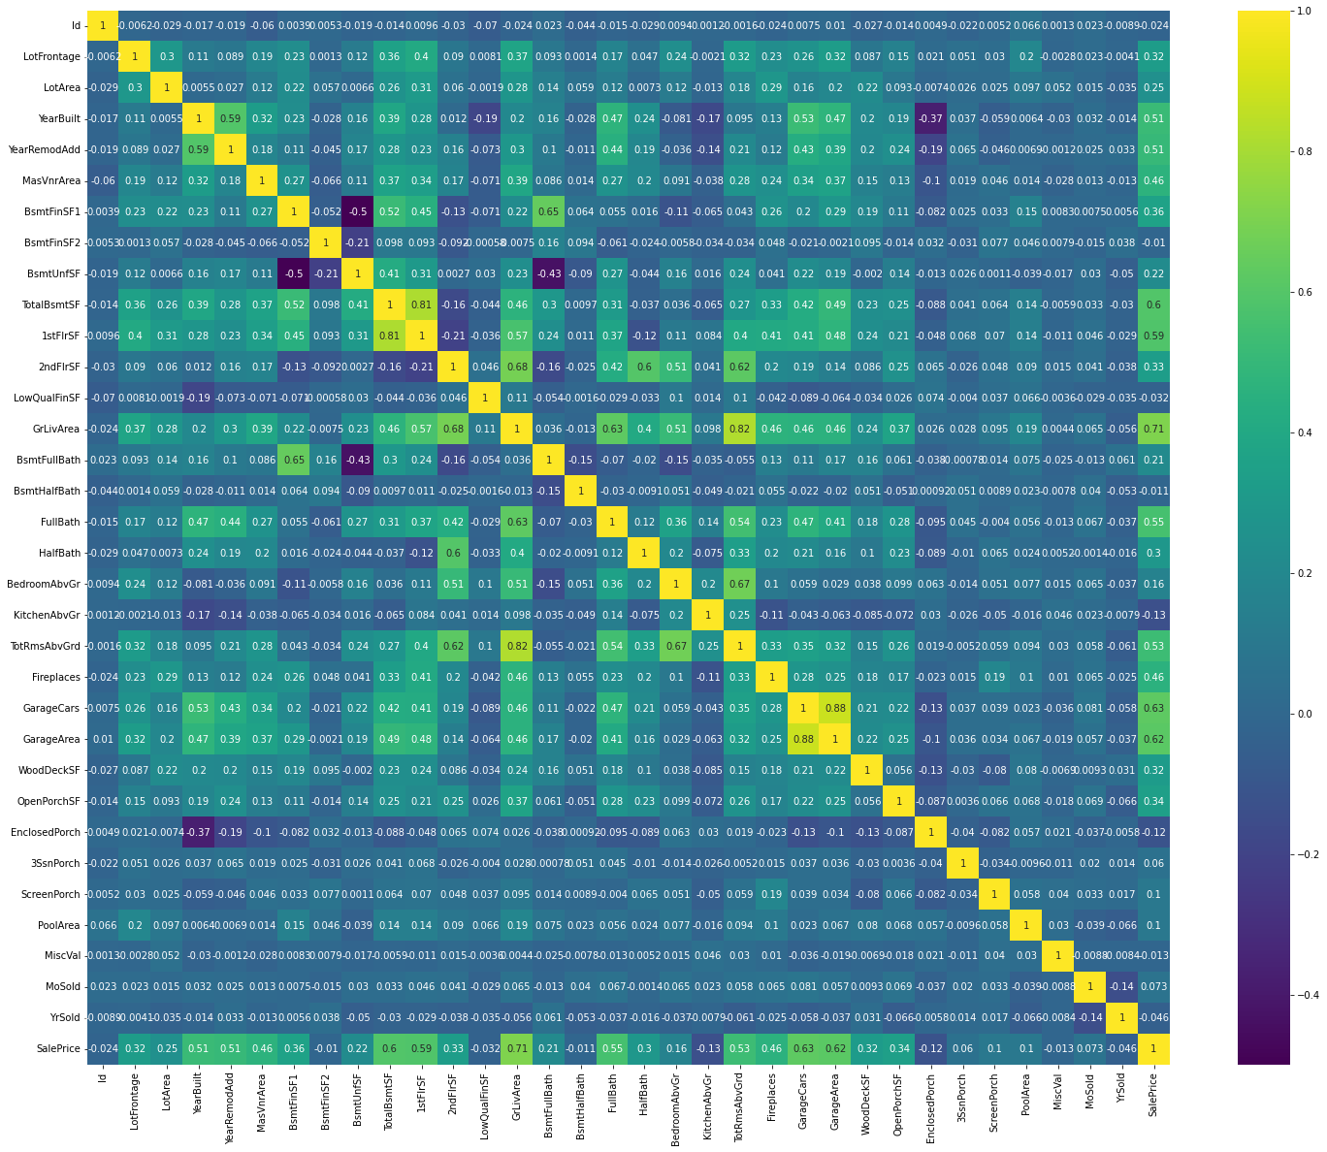
Correlation of Each Column

Slide 8
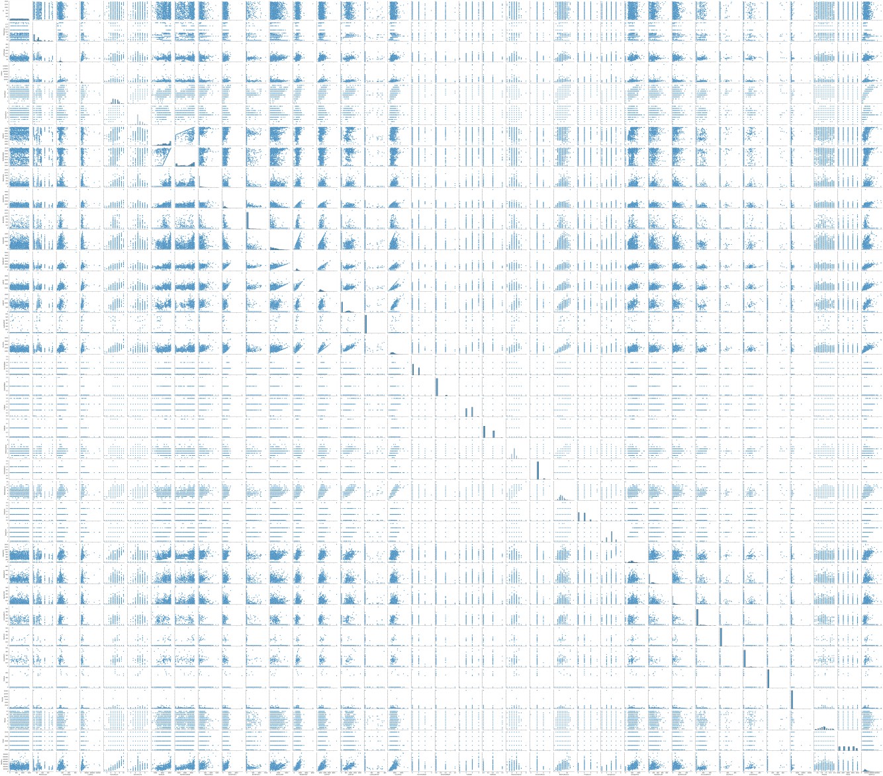
Pair-plot

Slide 9
Outliers Treatment
An Outlier is an observation in a given dataset that lies far from the rest of the observations. That means an outlier is vastly larger or smaller than the remaining values in the set.
Steps for the treatment of Outliers
Calculate the 1st and 3rd quartiles(Q1, Q3)
Compute IQR=Q3-Q1
Compute lower bound = (Q1–1.5*IQR), upper bound = (Q3+1.5*IQR)
Box plot of treated data in next slide

Slide 10
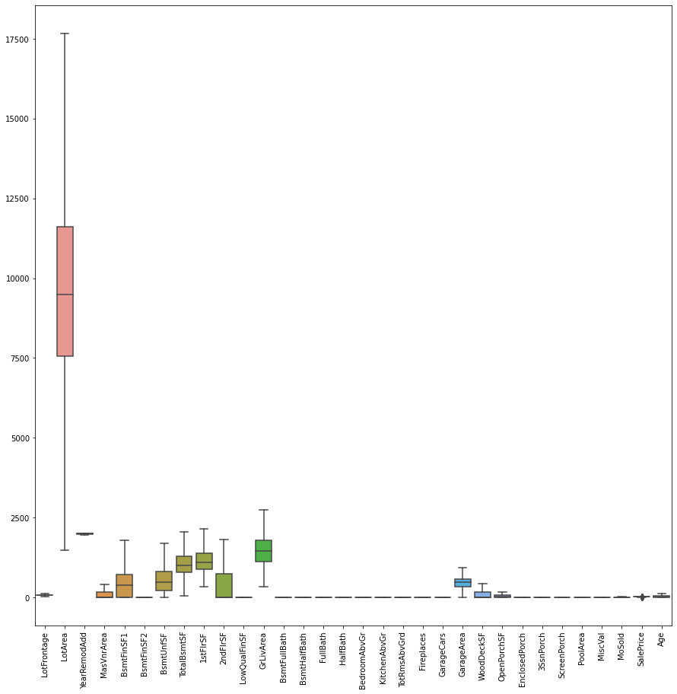
Outlier Treatment

Slide 11
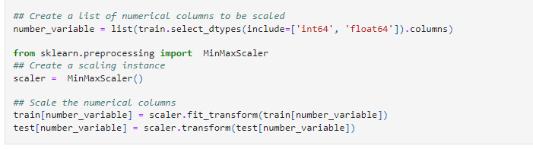
Data Pre-Processing
Scaling the target value is a good idea in regression modelling; scaling of the data makes it easy for a model to learn and understand the problem. Scaling of the data comes under the set of steps of data pre-processing when we are performing machine learning algorithms in the data set
I have used Min Max scaler from sklearn.Pre-Processing
The Code

Slide 12
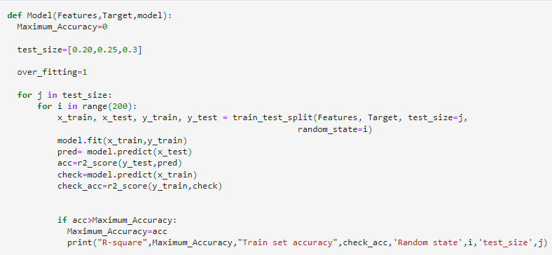
Model Building
The model building process involves setting up ways of collecting data, understanding and paying attention to what is important in the data to answer the questions you are asking, finding a statistical, mathematical or a simulation model to gain understanding and make predictions.
I have used three models only : Lasso Regression,Random Forest Regression, Xg-Boost Regression.
While all the three performed well the Lasso Regression was best choice as the other two were may had the chances of Over-Fitting.
Code:

Slide 13
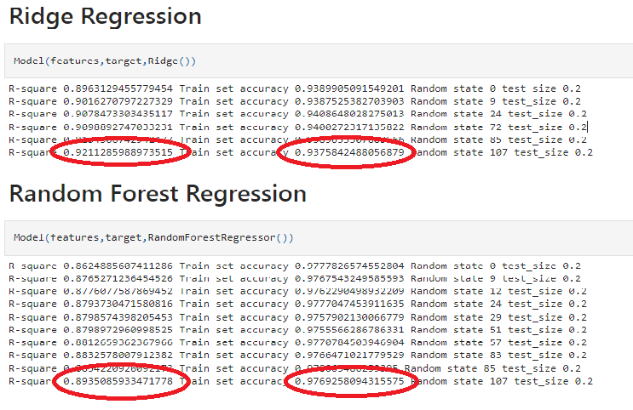
Evaluatuon of model
There is a big difference in the performance of the data on test and training set.

Slide 14
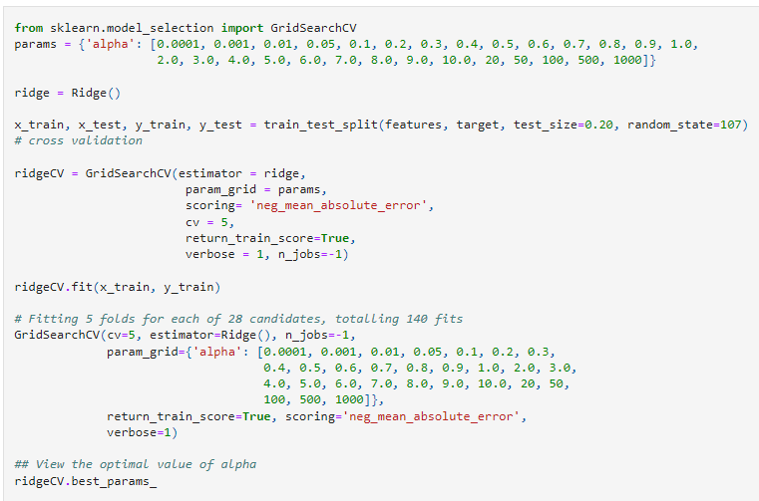
Picked Final model (lasso)
As the model was preforming better than the other two Regression Model I have picked it.
Hyper-parameteric tunning with Cross- validation.

Slide 15
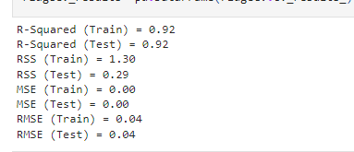
Evaluation of the final model
In regression problems there are three parameter to judge the performance of a model
Residual sum of squares of train and test data
Mean Squared Error of train and test data
Root Mean Squared Error for train and test

Slide 16
Top Contributor to the price of a House
GrLivArea :an increase of 1 square foot of house area above ground, the price will increase by 1.065185 times
1stFlrSF : if an increase in First Floor square feet area by 1 then price will increase by 1.052968 times
TotalBsmtSF :an increase of 1 square foot of basement area above ground, the price will increase by 1.046094 times
OverallQual_9 if the overall material and finish of the house is Excellent, the price of house will increase by 1.039479 times
Neighborhood_StoneBr: if Stone Brook is a nearby location, then the price of house will increase by 1.030926 times
GarageArea: an increase of 1 square foot of Garage Area ,the price will increase by 1.027725 times
GarageCars:an increase 1 car capacity of Garage Cars, the price will increase by 1.027691 times
CentralAir_Y :if there is a Central air conditioning, the price will increase by 1.030009 times
LotArea : an increase of 1 square foot of Lot Area ,the price will increase by 1.033287 times

Slide 17
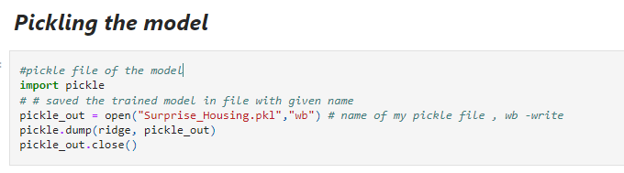
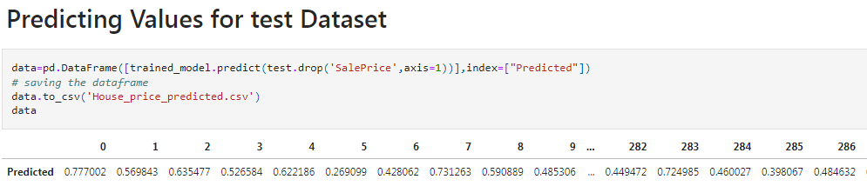
Saving the model in a Pickle file
Pickle in Python is primarily used in serializing and deserializing a Python object structure. In other words, it's the process of converting a Python object into a byte stream to store it in a file/database, maintain program state across sessions, or transport data over the network.

Slide 18
Conclusion
The objective of this paper is to fit models to predict the housing sale price and find some important aspects of the house.
In order to achieve my goal, I fit three models to the dataset: lasso regression, random forest and Xgboost. As for the first model -lasso regression, but the Rmse and R-squared looks not so good.
The second model is Random Forest. The Rmse of this model are relative low in both the training set and test set, which shows the predictions seems not bad. What’s more, The R squared in this model of training set is very good, but in the test set the R squared is relatively high, which may show the Random Forest model is a little bit overfitting.
Finally,I try the third model -Xgboost. All of the results of this Lasso model seem good but in the test set the R squared is relatively high, which may show the Xgboost model is a little bit overfitting.
Therefore, I will use this Lasso model as my final model to predict the housing price.What’s more, from the feature importance plot of the Lasso, we can know that the total square feet, the overall quality, and the total number of bathrooms are the three main aspects which influence the housing sale price.

Slide 19
Thank you

